Slide 1

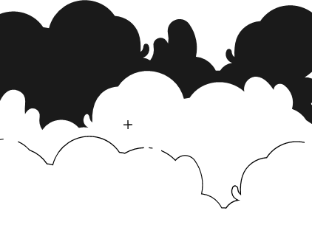
PRINCIPLES OF ARTIFICIAL INTELLIGENCE
SOF106
DR SHAMINI RAJA KUMARAN
PROBLEM FORMULATION
N-QUEEN
www.website.com
PREPARED BY DR SHAMINI

Slide 2
XMUM VISION
Xiamen University Malaysia aspires to become a university with a distinct global outlook, featuring first-class teaching and research, and embracing cultural diversity.
XMUM MISSION
To nurture young talents with dignity and wisdom, turning them into fine citizens of the region who will contribute to the prosperity of the people and social progress of Malaysia, China and Southeast Asia.To nurture young talents with dignity and wisdom, turning them into fine citizens of the region who will contribute to the prosperity of the people and social progress of Malaysia, China and Southeast Asia.

Slide 3
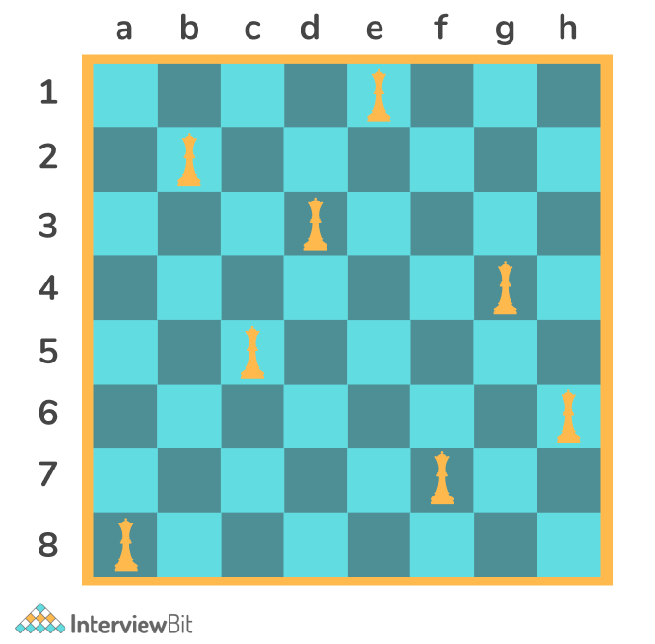
8-QUEEN PROBLEM
Given a 8 X 8 chessboard. The task is to place 8 queens on the board, such that no two queens attack each other. Return all distinct possible solutions for the 8 queens problem.

Slide 4
8-QUEEN PROBLEM
You have an empty chessboard.
After you place the first queen anywhere you want on the first column, you move on to the second column and search for a square to place the second queen.
If you succeed, you move on to the third column and so on. After n steps, you will realize that since you started randomly, you probably ran out of spaces to place a queen onto the nth column.
If that is the case, you go back one step and search for an alternative square for the (n-1)th queen. If there are no alternative steps, you remove that queen as well and go back to the (n-2)th column to search for an alternative square. If you find one, you move forwards again to (n-1) and keep going.
Hereby, we will use recursive function.
The recursive nature of this function allows it to explore all possible combinations of queen placements while backtracking when it encounters conflicts. It effectively searches for a valid solution to the 8-Queens problem.

Slide 5
8-QUEEN PROBLEM
Let’s look at https://www.cs.usfca.edu/~galles/visualization/RecQueens.html to solve the n-queens problem.
If you would like to play game of n-queen : https://www.brainbashers.com/queens.asp.
If you would like to visualize n-queen : https://nqueen.netlify.app/

Slide 6
THANK YOU
www.website.com
PREPARED BY DR SHAMINI

